Slide 1

CISC 250 – Business Telecomm Networks
Data Link Layer & Local Area Network

Slide 2
Outline
LAN protocol architecture
LAN devices
MAC Address and ARP
Ethernet
LAN media access methods

Slide 3
LAN Protocols: Data Link Layer
“link”
Data link layer has responsibility of transferring datagram from one node to adjacent node over a link
Datagram transferred by different link protocols over different links:
e.g., Ethernet on first link, frame relay on intermediate links, 802.11 on last link
Each link protocol provides different services
Data link layer packet is called frame, encapsulates network layer datagram (e.g. IP packet)

Slide 4
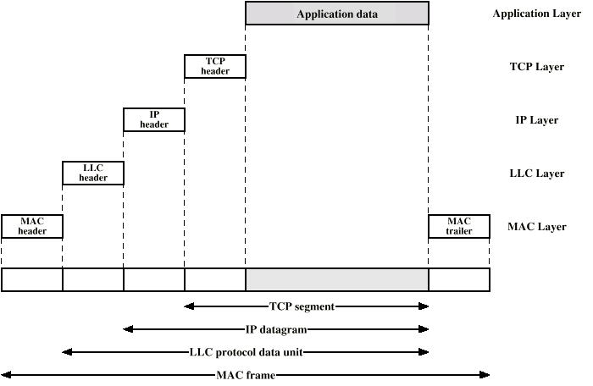
LAN Protocols: Frame

Slide 5
Adaptors Communicating
datagram
Data link layer protocol
rcving
node
sending
node
frame
frame
adapter
adapter
Data link layer implemented in Network Interface Card (NIC) (aka “adaptor”)
Ethernet card, PCMCIA card, 802.11 card
sending side:
encapsulates datagram in a frame
adds error checking bits, flow control, etc.
receiving side
looks for errors, flow control, etc
extracts datagram, passes to rcving node

Slide 6
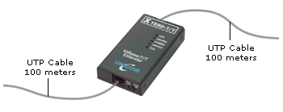
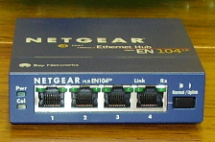
LAN Devices
Repeater
Allows signal to travel a longer distance on the media
Classified as layer 1 (physical layer) device
Hub
Also known as a multi-port repeater
Creates central connection point for wiring media
Classified as layer 1 (physical layer) device

Slide 7
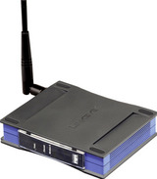
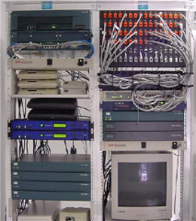
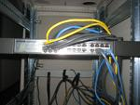
LAN Devices
Bridge
Connects two LAN segments to make one larger continuous LAN
Considered layer 2 (data link Layer) device
Switch
Sometimes called a multi-port bridge
Forwards data only to the appropriate port for the intended recipient
Considered layer 2 (data link Layer) device

Slide 8
MAC Addresses
Each adapter on LAN has an unique MAC address
1A-2F-BB-76-09-AD
Broadcast address =
FF-FF-FF-FF-FF-FF
LAN
(wired or
wireless)
= adapter
71-65-F7-2B-08-53
58-23-D7-FA-20-B0
0C-C4-11-6F-E3-98

Slide 9
MAC Addresses
MAC address:
is used to get frame from one interface to another physically-connected interface (same network)
48 bit MAC address (for most LANs) burned in the adapter ROM
Usually expressed for humans in hexadecimal
Base 16: Each symbol represents 4 bits (for example, 0101=5 hex)
Convert each four bits to a hex symbol between 0 and F
Put dashes between each pair
Example: A1-34-CD-7B-DF-89

Slide 10
MAC Address
MAC address allocation administered by IEEE
manufacturer buys portion of MAC address space (to assure uniqueness)
Analogy:
MAC address: like Social Security Number
IP address: like postal address
MAC flat address ➜ portability
can move LAN card from one LAN to another
IP hierarchical address NOT portable
depends on IP subnet to which node is attached

Slide 11
IP Address vs. MAC Address

Slide 12
ARP: Address Resolution Protocol
Question: how to determine
MAC address of B
knowing B’s IP address?
Each IP node (Host, Router) on LAN has ARP table
ARP Table: IP/MAC address mappings for some LAN nodes
< IP address; MAC address; TTL>
TTL (Time To Live): time after which address mapping will be forgotten (typically 20 min)
137.196.7.78
1A-2F-BB-76-09-AD
137.196.7.23
137.196.7.14
LAN
71-65-F7-2B-08-53
58-23-D7-FA-20-B0
0C-C4-11-6F-E3-98
137.196.7.88

Slide 13
ARP protocol: Same LAN
A wants to send datagram to B, but B’s MAC address is not in A’s ARP table.
A broadcasts ARP query frame, containing B's IP address
Dest MAC address = FF-FF-FF-FF-FF-FF
all machines on LAN receive ARP query
B receives ARP frame, replies to A with its (B's) MAC address
frame sent to A’s MAC address (unicast)
A caches (saves) IP-to-MAC address pair in its ARP table until information becomes old (times out)
soft state: information that times out (goes away) unless refreshed
ARP is “plug-and-play”:
nodes create their ARP tables without intervention from net administrator

Slide 14
LAN Protocols: IEEE 802 Standards
Internet Layer
TCP/IP Internet Layer
Standards
Other Internet Layer
Standards
Data
Link
Layer
Logical
Link
Control
Layer
802.2
Media
Access
Control
Layer
Ethernet 802.3 MAC Layer
Standards
Other MAC
Standards
(802.5,
802.11, etc.)
Physical Layer
10
Base-T
100
Base-TX
1000
Base-TX
Other
Physical
Layer
Standards
(802.5,
802.11, etc.)

Slide 15
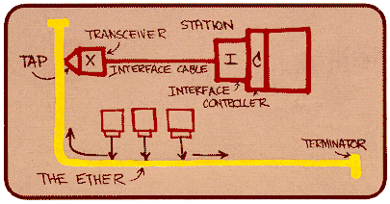
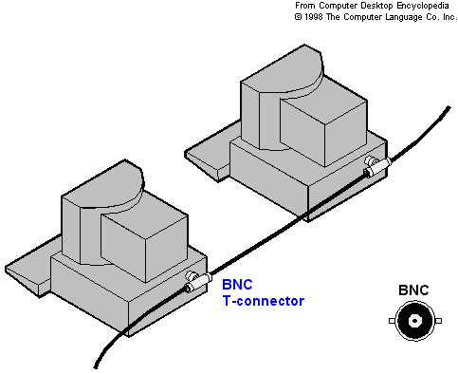
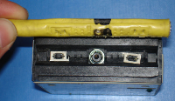
Ethernet – IEEE 802.3
“dominant” wired LAN technology:
Cheap - $20 for 100Mbs!
first widely used LAN technology
Kept up with speed race: 10 Mbps – 10 Gbps
Connection choices: hub or switch
Metcalfe’s Ethernet sketch

Slide 16
Ethernet Standards: Physical Layer
802.3 10Base-T
10 Mbps
802.3 100Base-TX
100 Mbps
802.3 1000Base-T
Gigabit Ethernet
Physical
Layer
Notes:
> Hello can anyone tell me what the X indicates in a TX or FX cable. > It doesn't "stand for" anything. When we were developing the 100 Mb/s Ethernet standard, a proposal was initially presented for an encoding scheme that supported both twisted pair and fiber. To facilitate discussion, it was called "100BASE-X", where the "X" was a placeholder for whatever medium would ultimately be used. The symbolism stuck and we kept the "X" designation to indicate the use of 4B/5B block encoding; -TX meant that coding on twisted pair, and -FX meant that encoding used on fiber.

Slide 17
UTP (unshielded twisted pair)
Cat 1: Previously used for POTS telephone communications, ISDN and doorbell wiring.
Cat 2: Previously was frequently used on 4 Mbps token ring networks.
Cat 3: used for data networks using frequencies up to 16 MHz. Historically popular for 10 Mbps Ethernet networks.
Cat 4: Provided performance of up to 20 MHz, and was frequently used on 16 Mbps token ring networks.
Cat 5: Provided performance of up to 100 MHz, and was frequently used on 100 Mbps Ethernet networks. May be unsuitable for 1000BASE- T gigabit Ethernet.
Cat 5e: Provides performance of up to 100 MHz, and is frequently used for both 100 Mbps and Gigabit Ethernet networks.
Cat 6: Provides performance of up to 250 MHz, more than double category 5 and 5e.
Cat 6a: Provides performance of up to 500 MHz, double that of category 6. Suitable for 10GBase-T.

Slide 18
LAN Media Access Methods
Determines how nodes share channel, i.e., determine when node can transmit
two or more simultaneous transmissions by nodes: interference
collision if node receives two or more signals at the same time
Two main ways
CSMA/CD – used in Ethernet (MAC Layer)
http://www.youtube.com/watch?v=yGJGIUa-xWE
Token passing

Slide 19
Carrier Sense Multiple Access with Collision Detection (CSMA/CD)
Carrier Sense Multiple Access (CSMA)
If a NIC wishes to transmit, it must listen for traffic
If there is no traffic, the NIC may transmit
If there is traffic, the NIC must wait to transmit until no traffic is being transmitted; then it may send

Slide 20

Carrier Sense Multiple Access with Collision Detection (CSMA/CD)
Collision Detection (CD)
If there is a collision (by two or more stations transmitting at the same time),
All NICs stop transmitting and wait for a random amount of time
The first NIC that finishes its wait may transmit
but only if there is no traffic!
If there is traffic, the NIC must wait until there is no traffic
If there are multiple collisions,
The random wait is increased each time
After 16 collisions, the sending NIC discards the frame

Slide 21


